Slide 1
Environmental Pollution-Sources and Impacts
Venna Nair
Assistant Professor
Dept. of English
N.S.S. College Pandalam

Slide 2
Pollution
Introduction of substances or energy by humans, deliberately or inadvertently into the environment resulting in a deleterious effect.
EPA Definition:
The presence of a substance in the environment that because of its chemical composition or quantity prevents the functioning of natural processes and produces undesirable environmental and health effects. Substances which discharged into the surroundings, where they bring about undesirable changes
Pollution is drastically rising in all the countries due to rise in human activity associated with modern technology and population growth.
Pollution poses health hazards, endangers wild life and makes the planet unsafe for future human survival.

Slide 3
Classification of Pollutants
According to their natural disposal, pollutants can be classified as
Degradable
Slowly degradable
Non-degradable
Based on their nature
Physical [ heat , noise]
Chemical [ acids ,poisonous gases ]
Biological [ pathogenic organisms ]
Geochemical [ sediments ,dust ]

Slide 4
How many types of pollution affect the environment?
There are 2 different types of pollution
•Point Source Pollution
•Non-point Source Pollution
Point Source Pollution:
Pollution caused from a stationary location or fixed facility where pollutants are discharged; any single identifiable source of pollution.
Eg. Chemicals coming out of pipes,
Oil Spill from Ship, Smoke from a factory.

Slide 5
Non-point Source Pollution
Non-point source pollution is the type of pollution that cannot be easily tracked back to its source.
You cannot identify (point to) the source of this pollution; this type of pollution happens everyday in all communities.
Common non-point sources are agriculture, forestry, urban, mining, construction, dams, channels, land disposal, saltwater intrusion, and city streets.

Slide 6
Effects of Non-point Source Pollution:
This type of pollution kills more animals and plants in the ocean than point source pollution.
It does not always immediately destroy habitats or kill large amounts of life at one time.
Many animals may die from immediate exposure to trash (an example of non-point source pollution), but do not usually die in large groups from the same pollution item at the same time.

Slide 7
Case Study: DDT Pesticide Exposure
DDT was a popular pesticide used from the 1940s to the 1970s in the United States of America to control insect pests affecting farms, forests, and home gardens.
Many people were exposed to this chemical by using it regularly, but many ocean animals were also exposed to it when rain would wash this chemical into the storm drains and out into the ocean.
In 1972, the EPA banned the usage of this chemical due to the increase of cancer among people and the widespread decline of bird
species.

Slide 8
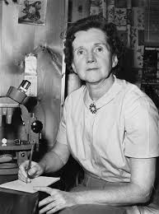

Slide 9
1962 ‘Silent Spring’ is published.
Rachel Carson’s powerful book draws the attention of the American public to the potential consequences of the increasing ability of human activities to significantly and even permanently alter the natural world.

Slide 10
Different Types of pollution are categorized based on the part of the environment which they affect, or result which the particular pollution causes.
Each of these types has its own distinctive causes and consequences.
The main types of pollution are:
Water Pollution
(Groundwater and Surface water pollution -River, lake and Oceans)
Air Pollution
Soil Pollution
Thermal Pollution
Radioactive Pollution
Noise Pollution

Slide 11
Water Pollution
The type of pollution that involves the contamination of various water bodies.
Various aquatic creatures depend on these water bodies and its natural nutritious features to support its life.

Slide 12
Types of Pollutants
Disease-causing Agents – Pathogens
Oxygen Demanding Agents – Organic waste: manure
Water-soluble Inorganic Chemicals – acids, toxic metals
Inorganic Plant Nutrients – nitrogen and phosphorus
Organic Chemicals – oil, pesticides, detergents
Sediment or Suspended Material – due to soil erosion.
Water-soluble Radioactive Isotopes – radon, uranium
Heat – electric and nuclear power plants.

Slide 13
Causes of Water Pollution
Industrial waste gets dumped into these water bodies. This causes a chemical imbalance in the water leading to death of the aquatic beings.
Insecticides, pesticides and ripening chemicals that are used on plants run into the ground water system or nearby streams.
Washing clothes near lakes and rivers causes detergents also causes a condition called “Eutrophication” which blocks sunlight from entering inside and reduces oxygen values in the water causing an inhabitable environment.

Slide 14
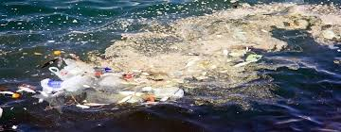
Marine Pollution

Slide 15
Causes
Overexploitation of fisheries and physical destruction of marine coastal habitats by dredging.
Strong increase in coastal development discharge of untreated sewage into the near-shore waters, resulting in enormous amounts of nutrients spreading into the sea and coastal zones.
Oil spills.

Slide 16
Oil Spills
‘Oil Spills’ are caused when giant oil tankers and oil rigs which are present in the oceans are damaged by either natural or human errors cause a long-time damage to the ocean as oil is lighter than water and floats on water forming a layer blocking sunlight.
Certain natural disasters like flash floods and hurricanes cause the intermixing of water with harmful substances on the land.

Slide 17
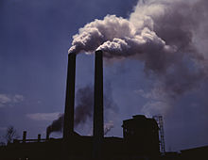
AIR POLLUTION

Slide 18
According to Indian Air amendment Act, 1987, “air pollution means any solid, liquid, or gaseous substances present in the atmosphere in such concentrations that may tend to be injurious to human beings or other living creatures or plants or property or enjoyment”.

Slide 19
TYPES OF AIR POLLUTION Outdoor and Indoor Pollution
Quantitative alteration of atmospheric constituents or addition of one or more contaminants in the outdoor atmosphere for such duration and such quantities that are injurious to human health, his belongings or plants and animal life is called outdoor pollution.
eg. lead, sulphur oxides, pollens, ozone, organic substances, carbon monoxide, nitrogen oxides, suspended particulate matter, polycyclic hydrocarbons.
Pollution of the atmosphere indoors(inside enclosed) buildings, home, office etc. is called indoor pollution.
eg. Ammonia, Asbestos and synthetic fibers, adhesives, formaldehyde, radon, cosmetics, solvents, allergens.

Slide 20
Sources of Indoor Pollution
Cooking (CO, NO₂,particulate matter)
Air conditioners & refrigerators ( Fungi-Thermoactinomyces vulgares, and CFCs)
Air purifiers (paradi-chlorobenzene)
Painting & cosmetics (HCHO)
Cigarette smoking (HCHO, CO, Benzopyrene, organic particulate matter
Wood(CO, HC, Polycyclic Organic matter)
Dry cleaned clothes( trichloroethylene)
Photocopying machines (O₃)
Carpets and plastic products (Styrene)
Asbestos (Asbestos dust)
Electric stove (NO₂)
Building foundation,Granite (Radon)
Mosquito and cockroach repellents, Bed bugs, mites etc.

Slide 21
Main sources of air pollution (OUTDOOR)
Natural sources and Anthropogenic sources
The contribution of each source to local pollution will
vary according to …
the type and number of local industrial processes,
density and age of road transport and local weather
conditions.
Sources of air pollution refer to the various locations, activities or factors which are responsible for the releasing of pollutants into the atmosphere.
These sources can be classified into two major categories :

Slide 22
Natural sources
Dust from natural sources, usually large areas of land with little or no vegetation.
Volcanic activity, which produce sulfur, chlorine, and ash particulates.
Methane, emitted by the digestion of food by animals, for example cattle.
Radon gas from radioactive decay within the Earth's crust.

Slide 23
Radon is a colorless, odorless, naturally occurring, radioactive noble gas that is formed from the decay of radium.
Radon gas from natural sources can accumulate in buildings, especially in confined areas such as the basement and it is the second most frequent cause of lung cancer, after cigarette smoking.
Smoke and carbon monoxide from wildfires.
Vegetation, in some regions, emits environmentally significant amounts of Volatile Organic Carbons (VOCs) on warmer days.
These VOCs react with primary anthropogenic pollutants—specifically, NO₂, SO₂, and anthropogenic organic carbon compounds—to produce a seasonal haze of secondary pollutants..

Slide 24
Anthropogenic sources
Burning of fossil fuels and fires, emission from vehicles, rapid industralisation, agricultural activities, and wars are the major causes of air pollution.
Fossil fuel power stations in mainly rural areas and distributing the pollution produced more evenly via tall chimneys has resulted in improved urban air quality, though they still remain a major source of pollution, mainly sulphur dioxide and nitrogen oxides.
Better dispersion of pollutants emitted by tall chimneys leads to better dilution in the air and thus lower local concentrations of pollutants. This has however led to pollution being dispersed more widely and to transboundary air pollution.

Slide 25
Landfill and incineration are the two most common methods of waste disposal.
If not properly managed landfill sites can cause a number of problems.
These include the production of potentially explosive levels of methane gas (65%), dangerous levels of carbondioxide (35%), plus trace concentrations of a range of organic gases and vapours.
Landfill sites also have the potential to cause major odour when badly managed.

Slide 26
Types of Air Pollutants
Air pollutants are classified into two categories:
Primary and Secondary pollutants
Primary pollutants: Air pollutants directly released from any source.
Eg. carbon monoxide, nitric oxide, benzene, benzopyrene, particulate matter, lead, radioactive substances, hydrocarbons.
Much of the lead emitted by vehicles burning leaded petrol emerges as particles.
Diesel engines burn fuel in excess of air and so produce little carbon monoxide but, instead large quantities of carbon dioxide.
Secondary pollutants: Formed from primary pollutants under specific conditions
Eg. Nitric acid, ozone, smog.

Slide 27
Major Air pollution concerns
Problem | Cause | Effect
Sulfurous smog | SO₂ and smoke from industrial and domestic sources | Respiratory diseases, reduced visibility, Damage to materials and vegetation.
Photochemical smog | Exhaust gases from motor vehicles | Damage to health, materials and vegetation.
Global warming | CO₂ from power stations and CH₄ from paddy fields | Rising temperatures, climate change, flooding of low-lying areas.
Depletion of O₃ layer | CFCs from aerosol cans, refrigerators etc. | Increasing incidence of skin cancer due to increasing penetration of UV radiation.
Acid rain | SO₂ and No_{x} from power stations and motor vehicles | Damage to aquatic and terrestrial ecosystems, and materials.
Haze | Pollutants from forest fires | Reduced visibility, health effects.

Slide 28
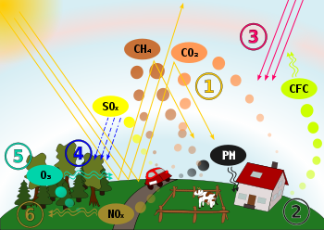
Causes and effects of air pollution:
(1) greenhouse effect, (2) particulate contamination,
(3) increased UV radiation, (4) acid rain, (5) increased ground level ozone concentration,
(6) increased levels of nitrogen oxides.

Slide 29
Air Pollution incidents in India
Industrial accidents
In Dec.3,1984, in Bhopal Methyl Isocyanate gas(MIC) from Union carbide Factory- India.
In August 1985, Chlorine spill occured at petrochemical plant at Chembur,
Bombay.
In December 4,1985 ,Oleum (55 tons) leakage at Shiram Foods &Fertiliser Industries, Delhi.

Slide 30
EPA CRITERIA AIR POLLUTANTS
OZONE (O3)
A colorless gas that forms as a result of chemical reactions between volatile organic compounds (VOCs), nitrogen oxides (NOx), and oxygen in the presence of heat and sunlight.
Sources:
Motor vehicles, electric utilities, factories, landfills, industrial solvents, and miscellaneous small sources such as gas stations, lawn equipment, etc.
Health and Environmental Effects
Stratospheric ozone depletion due to air pollution has long been recognized as a threat to human health as well as to the Earth's ecosystems.
Causes coughing, chest tightness, wheezing and can inflame and damage lung tissue.
Aggravates asthma and can even be a cause of asthma. Irritates the respiratory system, reduces lung function and makes it more difficult to breathe.
Aggravates chronic lung diseases and may cause permanent lung damage.
May reduce yield of agricultural crops and damages forests and other vegetation.

Slide 31
Particulate matter (PM-10) -- Particulate matter is a criteria air pollutant and is a finely divided particle with an aerodynamic diameter of 10 micrometers or less.
eg. Dust, soot and other tiny bits of solid materials that are released into and move around in the air.
Particulate pollution can cause eye, nose, and throat irritation and other health problems.
(24-hour average concentration -150 micrograms per cubic meter )
Particulate matter (PM2.5) -- Includes tiny particles with an aerodynamic diameter less than or equal to a nominal 2.5 microns. This fraction of particulate matter penetrates most deeply into the lungs.
(24-hour average concentration-35 micrograms per cubic meter)

Slide 32
Toxic air pollutants get into the body mainly through breathing. They can also be ingested or absorbed through the skin.
Once a pollutant enters the body it can stay in the lungs (like asbestos), be exhaled, or move into the blood from the lungs (like the oxygen we breathe) or from the digestive system or skin. In the blood it is carried to all parts of the body.
As it moves around the body, a pollutant can undergo chemical changes, especially as it passes through the liver, becoming less, or more, toxic.
At certain levels, toxic air pollutants can cause human health effects ranging from nausea and difficulty in breathing to cancer.
Health effects can also include birth defects, serious development delays in children, and reduced immunity to disease in adults and children.

Slide 33
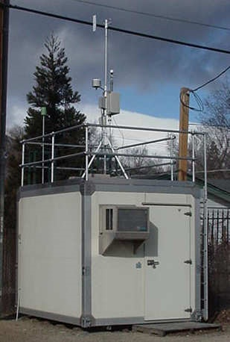
Air Quality Monitoring
Monitoring stations continuously monitor and collect information about the presence and level of atmospheric contaminants as well as the meteorological indices.
A typical monitoring station include sophisticated gaseous pollutant analyzers, particle collectors, and weather sensors that are continuously maintained and operated.
In India, with the help of state pollution control boards, monitors air pollutants in industrial areas and selected stations..

Slide 34
Measures to check indoor pollution
Using equipments like Air-washers, Bin vents, cartridge dust collectors .
Growing Common indoor plants like Spider plant, Bamboo palm, Peace lily, English Ivy.
Smoking should be avoided.
Dry cleaned clothes should be aerated outside the house.
Pads and water in desert cooler should be changed well before they get contaminated with fungi or other microorganisms.
Boracic powder (Boric acid, also called hydrogen borate, boracic acid) can be used on coakroaches.

Slide 35
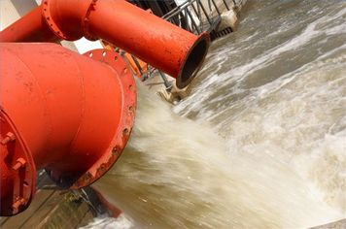
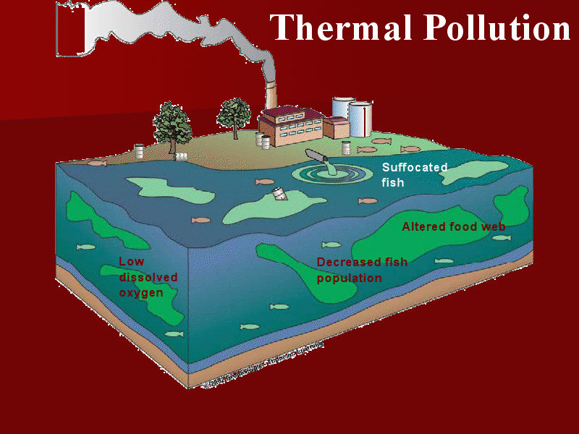
THERMAL POLLUTION - CAUSES AND IMPACTS

Slide 36
Thermal pollution may be defined as:
Addition of excess of undesirable heat to water that makes it harmful to man, animal or aquatic life or otherwise causes significant departures from the normal activities of aquatic communities in water

Slide 37
Sources of Thermal Pollution
The sources of Thermal pollution mainly include:
Nuclear Power Plants
Coal fired Power Plants
Industrial effluents
Domestic sewage
Hydro-electric power

Slide 38
Nuclear Power Plants
Emissions from nuclear reactors and processing installations are responsible for increasing the temperature of water bodies.
The operation of power reactors and nuclear fuel processing units constitute the major contributor of heat in the aquatic environment.

Slide 39
The liquid radioactive water consists of H-3, C-14, Fe-59 and Co-60 along with corrosion products.
In addition, accidental leakage of radiation from nuclear reactors in water raises the temperature of surrounding aquatic system.
Heated effluents from power plants are discharged at 10º C higher than the coolant receiving waters and severely affected the aquatic flora and fauna.

Slide 40
2. Coal fired power plants
These are the major source of thermal pollutants.
Their condenser coils are cooled with water from nearby lake or river and discharge the hot water back to the stream increasing the temperature of nearby water to about 15º C.
The heated effluents decrease the DO content of water resulting in the killing of fish and other marine organisms.

Slide 41
3. Industrial Effluents
The industries like textile, paper and pulp as well as sugar release heat in water.
The discharged water from steam-electric power industry using turbo generators, will have higher temperature ranging from 6ºC to 9ºC than the receiving water.

Slide 42
4.Domestic Sewage
Domestic sewage is commonly discharged into rivers, lakes, canals or streams with or with out waste treatment.
The municipal sewage has a higher temperature than the receiving water.
The discharged sewage not only raises the stream temperature to a measurable extent, but also creates numerous deleterious effects on aquatic biota.

Slide 43
With the increase in temperature of the receiving water, the DO content decreases and the demand of oxygen increases .
Hence, the anaerobic conditions will set up resulting in the release of foul and offensive gases in water.
The marine organisms which depend on the dissolved oxygen of the surface water will die out.

Slide 44
5.Hydro- electric power
Generation of hydro electric power, sometimes results in negative thermal loading in water systems.
Apart from electrical power industries, various factories with cooling requirement contribute to thermal loading.

Slide 45
Impacts of Thermal Pollution
The harmful impacts of thermal pollution mainly include:
Reduction in Dissolved Oxygen-
Concentration of dissolved oxygen decreases with increase in temperature of water.
Change in water properties-
A rise in temperature changes the physical and chemical properties of water.

Slide 46
The vapour pressure increases sharply, while the viscosity of water decreases.
The decrease in density, viscosity and solubility of gases increases the settling speed of suspended particles which seriously affects the food supply of aquatic organisms.
Interference with biological activities –
The temperature changes totally disrupt the entire ecosystem

Slide 47
Temperature is considered to be of vital significance to physiology, metabolism and biochemical process in controlling respiratory rates, digestion, excretion and overall development of aquatic organisms.
Interference with reproduction-
In fishes, several activities like nest building, spawning, hatching, migration, reproduction etc depend on some optimum temperature.

Slide 48
The warm water not only disturbs spawning, but also destroys laid eggs.
Change in metabolic rate-
Fishes show a marked rise in basal rate of metabolism with temperature to lethal point.
The respiratory rate, oxygen demand, food uptake and swimming speed in fishes increase

Slide 49
Increased vulnerability to disease -
Activities of several pathogenic microorganisms are accelerated by high temperature.
Hot water causes bacterial disease in Salmon fish.
Invasion of destructive organisms -
Thermal pollutants may permit the invasion of organisms that are tolerant to warm water and highly destrutive.

Slide 50
Undesirable changes in algae production –
The life in an aquatic ecosystem is greatly influenced by the growth of algae.
Excess nutrients from the wash out waters from farm lands, combined with thermal pollution cause an excessive algal growth with consequent acceleration of eutrophic and other undesirable changes.

Slide 51
Control of Thermal Pollution
Control of thermal pollution is an extreme necessity, since in future its detrimental effects on aquatic ecosystem may be worse.
The following methods can be adopted for the control of thermal pollution:
Cooling Towers
Cooling Ponds
Artificial Lakes

Slide 52
Cooling Towers
The use of water from water systems for cooling purposes, with subsequent return to the water way after passage through the condenser is termed as cooling process.
Cooling towers transfer some of the heat from cooling water to the surrounding atmosphere by the process of evaporation.

Slide 53
2. Cooling Ponds
Cooling ponds or reservoirs constitute the simplest method of cooling thermal discharges.
Heated effluents on the surface of water in cooling ponds maximize dissipation of heat to the atmosphere and minimize the water area and volume.

Slide 54
3. Artificial Lakes
Artificial lakes are man-made bodies of water which offer possible alternative to once through cooling.
The heated effluents can be discharged into the lake at one end and the water for cooling purposes may be withdrawn from the other end.
The heat is eventually dissipated through evaporation.
So, these lakes have to be rejuvenated continuously.

Slide 55
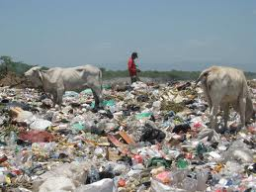
SOIL POLLUTION

Slide 56
SOIL POLLUTION
Soil pollution is defined as the build-up in soils of persistent toxic compounds, chemicals, salts, radioactive materials, or disease causing agents, which have adverse effects on plant growth and animal health.

Slide 57
Causes of Soil Pollution
Seepage from a landfill
Discharge of industrial waste and e-waste into the soil
Percolation of contaminated water into the soil
Rupture of underground storage tanks
Excess application of pesticides, herbicides or fertilizer (agrochemicals)
Solid waste seepage

Slide 58
Waste materials can be broadly divided into three categories:
Muncipal soild wastes (ie. from homes, hotels etc.)
Special wastes (medical waste, construction debris, asbestos, mining waste, agricultural waste, radioactive waste, sewage sludge)
Hazardous wastes : Waste with properties that make it capable of harming human health or the environment. eg. Electroplating wastes, spent solvents, heavy metals in e- waste, wood processing wastes.

Slide 59
Solid wastes
Any non liqiud, non- soluble materials ranging from municipal garbage to industrial wastes that contain complex and sometimes hazardous substances.
It include;
Garbage
Rubbish
Demolition wastes
Sewage treatment residue
Dead animals
Manure and other discarded materials.

Slide 60
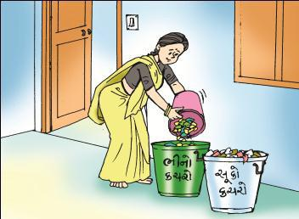
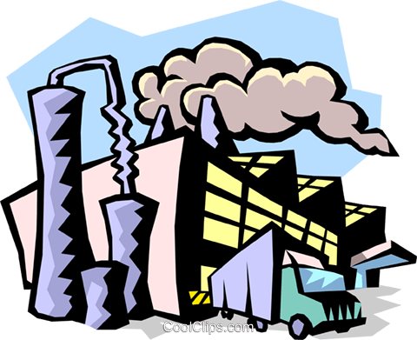
Sources of solid wastes
HOUSE HOLDS
AGRICULTURE
INDUSTRY
CONSTRUCTION
INSTITUTION S

Slide 61
Solid waste management “3rs”

Slide 62
Electronic waste (E-waste)
Among top ten cities generating e-waste, Mumbai ranks first followed by Delhi, Bangalore, Chennai, Kolkata, Ahmedabad, Hyderabad, Pune, Surat and Nagpur.

Slide 63
Composition of E-waste
Composition of E-waste is very diverse and differs in products across different categories. It contains more than 1000 different substances, which fall under “hazardous” and “non-hazardous” categories.
Broadly, it consists of ferrous and nonferrous metals, plastics, glass, wood & plywood, printed circuit boards, concrete and ceramics, rubber and other items. Iron and steel constitutes about 50% of the e-waste followed by plastics (21%), non ferrous metals (13%) and other constituents.
Non-ferrous metals consist of metals like copper, aluminium and precious metals eg. silver, gold, platinum, palladium etc.

Slide 64
Health effects
Contaminated or polluted soil directly affects human health through direct contact with soil or via inhalation of soil contaminants which have vaporized; potentially greater threats are posed by the infiltration of soil contamination into groundwater aquifers used for human consumption, sometimes in areas apparently far removed from any apparent source of above ground contamination.
Health consequences from exposure to soil contamination vary greatly depending on pollutant type, pathway of attack and vulnerability of the exposed population.

Slide 65
Bioaccumulation
Soil pollution can harm humans by bioaccumulation.
Plants that are grown in lightly polluted soil continuously absorb molecules of the pollutants. Since the plants cannot get rid of these molecules, they accumulate in the plant, causing higher amounts of pollution to exist in the plant than in the soil.
Animals who eat many of these polluted plants take on all the pollution those plants have accumulated. Larger animals who eat the plant-eating animals take on all the pollution from the animals they eat.
Humans who eat plants or animals that have accumulated large amounts of soil pollutants may be poisoned, even if the soil itself does not contain enough pollution to harm human health.

Slide 66
Solid Waste Management
Reusing of materials: Materials such as glass containers, plastic bags, paper, cloth etc. can be reused at domestic levels rather than being disposed, reducing solid waste pollution.

Slide 67
Recycling and recovery of materials
This is a reasonable solution for reducing soil pollution. Materials such as paper, some kinds of plastics, e-waste and glass can and are being recycled. This decreases the volume of refuse and helps in the conservation of natural resources.
For example, recovery of one tonne of paper can save 17 trees.

Slide 68
Reforesting
Control of land loss and soil erosion can be attempted through restoring forest and grass cover to check wastelands, soil erosion and floods.
Crop rotation or mixed cropping can improve the fertility of the land.

Slide 69
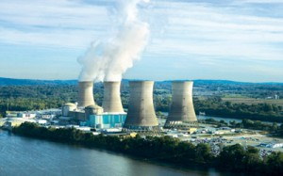
Radiation Pollution ( Nuclear hazard)

Slide 70
RADIATION
Radiation occurs when unstable nuclei of atoms decay and release particles.
Each radioactive element on the list gives off either alpha radiation or beta radiation -and sometimes gamma radiation too - thereby transforming itself into the next element
When uranium ore is extracted from the earth, most of the uranium is removed from the crushed rock during the milling process, but the radioactive decay products are left in the tailings.
Thus 85 percent of the radioactivity of the original ore is discarded in the mill tailings.

Slide 71
Man-made radiation sources (18%) that result in an exposure to members of the public:
Tobacco (thorium)
Televisions (tritium)
Medical X-rays (americium)
Smoke detectors (americium),
Lantern mantles (thorium)
Nuclear medicine (tritium)
Building materials ( radon. tritium)

Slide 72
Coal
Coal contains a small amount of radioactive uranium, barium, thorium and potassium, but, in the case of pure coal, this is significantly less than the average concentration of those elements in the Earth's crust.
Oil and gas
Residues from the oil and gas industry often contain radium and its decay products.
The sulfate scale from an oil well can be very radium rich, while the water, oil and gas from a well often contain radon.
The radon decays to form solid radioisotopes which form coatings on the inside of pipework.

Slide 73
Medical wastes
Radioactive medical waste tends to contain beta particle and gamma ray emitters. It can be divided into two main classes. In diagnostic nuclear medicine a number of short-lived gamma emitters such as technetium-99m are used. Many of these can be disposed of by leaving it to decay for a short time before disposal as normal waste.
Other isotopes used in medicine include:
with half-lives in parentheses,
Y-90, used for treating lymphoma (2.7 days)
I-131, used for thyroid function tests and for treating thyroid cancer (8.0 days)
Sr-89, used for treating bone cancer, intravenous injection (52 days)
Ir-192, used for brachytherapy (74 days)
Co-60, used for brachytherapy and external radiotherapy (5.3 yrs)

Slide 74
Effects of Radiation Exposure on Human Health
Although a dose of just 25 rems causes some detectable changes in blood, doses to near 100 rems usually have no immediate harmful effects.
Doses above 100 rems cause the first signs of
radiation sickness including:
nausea
vomiting
headache
some loss of white blood cells
Genetic effects and the development of cancer are the primary health concerns attributed to radiation exposure.

Slide 75
The common types of radiation detectors include:
Ionization (Ion) Chamber
Radon Detectors
Geiger-Mueller counter.

Slide 76
AT1103M X-RAY Radiation Dosimeter
Unique highly-sensitive devise for measuring radiation exposure on crystalline lens, mucus membranes and skin. Measures directed dose equivalent rate of continuous X-ray radiation with energy from 5 keV.

Slide 77
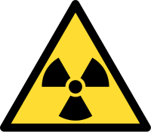
International radioactive waste hazard symbol featuring the trefoil design.
Nuclear fallout is the distribution of radioactive contamination by a nuclear explosion.
Contamination may occur from radioactive gases, liquids or particles.

Slide 78
Suggested Readings:
1. Carson, R. 2002. Silent Spring. Houghton Mifflin Harcourt.
2. Gadgil, M., & Guha, R.1993. This Fissured Land: An Ecological History of India.
Univ. of California Press.
3. Gleeson,B. and Low, N. (eds.) 1999. Global Ethics and Environment, London,
Routledge.
4. Gleick, P.H. 1993. Water in Crisis. Pacific Institute for Studies in Dev.,
Environment & Security. Stockholm Env. Institute, Oxford Univ. Press.
5. Groom, Martha J. Gary K. Meffe, and Carl Ronald carroll. Principles of
Conservation Biology. Sunderland: Sinauer Associates, 2006.
6. Grumbine, R. Edward, and Pandit, M.K. 2013. Threats from India’s Himalaya
dams. Science, 339: 36-37.
7. McCully, P.1996. Rivers no more: the environmental effects of dams(pp. 29-64).
Zed Books.
8. McNeil, John R. 2000. Something New Under the Sun: An Environmental
History of of the Twentieth Century.

Slide 79
9. Odum, E.P., Odum, h.T. & Andrews, J.1971. Fundamentals of Ecology.Philadelphia: Saunders.
10. Pepper, I.L., Gerba, C.P. & Brusseau, M.L. 2011. Environmental and Pollution
Science. Academic Press.
11. Rao, M.N. & Datta, A.K. 1987. Waste Water Treatement. Oxford and IBHPublishing Co. Pvt. Ltd.
12. Raven, P.H., Hassenzahl, D.M. & Berg, L.R. 2012. Environment. 8th edition.
John Wiley & Sons.
13. Rosencranz, A., Divan, S., & Noble, M.L. 2001. Environmental law and policy inIndia. Tripathi 1992.
14. Sengupta, R. 2003.Ecology and economics: An approach to sustainable development. OUP.
15. Singh, J.S., Singh, S.P. and Gupta, S.R. 2014. Ecology, Environmental Sciencea nd Conservation. S. Chand Publishing, New Delhi.
16. Sodhi, N.S., Gibson, L. & Raven, P.H. (eds). 2013. Conservation Biology: Voices from the Tropics. John Wiley & Sons.
17. Thapar, V. 1998. Land of the Tiger: A Natural History of the Indian Subcontinent.
18.Warren, C.E. 1971. Biology and Water Pollution Control. WB Saunders.
19.Wilson, E.O. 2006. The Creation: An appeal to save life on earth. New York:
Norton.
20.World Commission on environment and Development. 1987. Our Common
Future. Oxford University Press.
21. www.nacwc.nic.in
22.www.opcw.org

Slide 80
THANK YOU

